Slide 1






PRESENTATION 2026
Faculty Name
Faculty Email
Dr. K.KARPAGAMBIGAI
drkarpagambigaik@veltech.edu.in
Mentor Name
Ms. R. UMAHESWARI

Slide 2
EDUPULSE: AI-DRIVEN REAL-TIME STUDENT FEEDBACK ANALYTICS FOR SMART LEARNING
Dr. K.KARPAGAMBIGAI
ASSISTANT PROFESSOR,
DEPARTMENT OF COMMERCE VELTECH UNIVERSITY-CHENNAI

Slide 3

OUTLINE
Abstract of the Project
Problem Statement
Proposed Solution
System Architecture
Live Demo of the Project
Embedded Video of Project
Conclusion
Future Scope

Slide 4

ABSTRACT
This Project focuses on the application of data analytics and artificial intelligence tools to evaluate Student Feedback for the Subject -Cost Accounting across the course B.Com-Specializations. The dataset consists of 480 student responses collected under multiple themes, analysed and derived a Faculty Performance-Metrics results.
The Objectives of the study were analyze the structured student feedback dataset to determine faculty performance Evaluation and course effectiveness using quantitative and AI techniques. The interactive dashboards were created using Microsoft Excel and Power BI. The AI tools such as Microsoft Copilot and chat bot systems were build for automated insight generation.
The Results highlights key performance indicators and highlight areas requiring improvement in teaching and learning processes. Faculty performance evaluation indicated measurable differences in effectiveness, and the dashboard visualizations provided clear insights into strengths and weaknesses across themes.
Application of AI tools
Enhanced the speed and accuracy of analysis.
Enabling efficient Performance evaluation and decisions.

Slide 5

PROBLEM STATEMENT
Educational institutions collect student feedback to evaluate teaching effectiveness and course quality and overall learning out comes. The collected Feedback data were underutilized due to operational barriers and analytical limitations. The traditional methods of analyzing feedback are often manual and time-consuming,
Lack of Systematic approach of identifying the actual Faculty performance Evaluation.
Lack of Learning Exposure and Identification of Improvement areas to Students
Absence of Integrated analytical tools and Visualization Mechanism
Adoption of limited of AI-driven tools
Lack of Real-Time and Automated Insights
The Core problem addressed in this project is the need to transform student feedback data on cost accounting Course of B.Com-Students into meaningful, accurate, and actionable insights using AI-based analytics. This will enable effective evaluation of faculty performance, identification of improvement areas, and enhancement of the overall teaching–learning process of Cost Accounting course of B.Com students.

Slide 6

PROPOSED SOLUTION
The solutions emphasize a Multi-Dimensional Analysis Strategy integrating teaching quality, Learning outcomes, Scholastic performance of the student, Rating scores dimensions, Improvements area assessment and Performance Evaluation Ranking Results and Decisions. .
Develop a Teaching quality assurance framework teaching effectiveness.
Check the Learning Outcome Level with Outcome-Based Education (OBE) standards.
Measure the Scholastic performance of the student towards the course and their learning experience.
Interprets the Faculty Performance metrics and Students Enhancement in Smart learning
This approach ensures enhanced Faculty Performance, Student satisfaction, Improved learning outcomes, and continuous academic excellence in the Cost Accounting course.

Slide 7
COURSE | BACHELOR OF COMMERCE- B.COM
SPECIALIZATION | B.COM GENERAL -120 RESPONSES B.COM ACCOUNTING & FINANCE -120 RESPONSES B.COM COMPUTER APPLICATIONS -120 RESPONSES B.COM COR.SECRETARYSHIP -120 RESPONSES
SUBJECT | COST ACCOUNTING
FACULTY NAME | PROF- MEENA-B.COM-GENERAL PROF-SEETHA- B.COM- AF PROF-SURESH-B.COM-CA PROF-KUMAR-B.COM-CS
TOTALSTUDENT RESPONSES | 480

Slide 8
Multi Dimensional Feedback Variables
Syllabus Coverage and Preparation -SC
Communication and Methodology -CM
Assessment and Feedback -AF
Growth and Opportunities -GO
Teaching Support and Engagement -TE
Skills and Employability –SE
Student Fulfillment-SF

Slide 9
Syllabus Coverage and Preparation (SC) | SC_Q1: Defined Syllabus clarity SC_Q2: Planned Schedule adherence SC_Q3: Adequate Topic explanation SC_Q4: Sufficient Lecture preparation SC_Q5: Structured learning Framework
Communication and Methodology (CM) | CM_Q1: Concepts clarity CM_Q2: Appropriate Teaching Method CM_Q3: Real time Examples and Illustrations CM_Q4: Good Teaching Pace CM_Q5: Immediate Query Resolution
Assessment and Feedback (AF) | AF_Q1: Regular Assessment AF_Q2: Exam Oriented Revision AF_Q3: Timely Feedback AF_Q4: Monitor Performance Status AF_Q5: Evaluation Transparency
TEACHING EXCELLENCE ANALYTICS

Slide 10
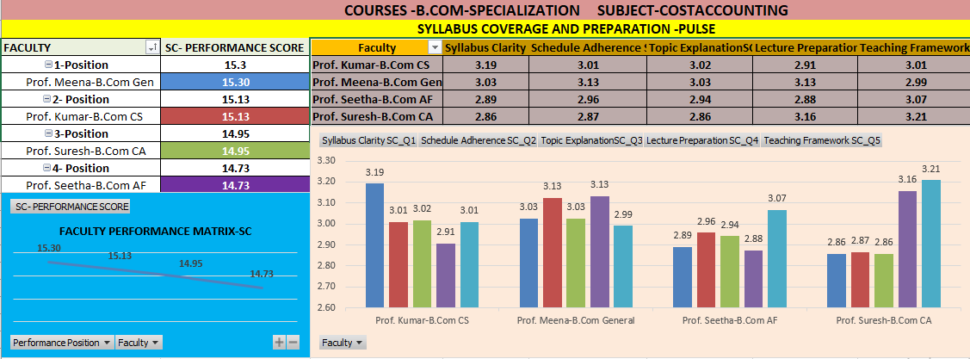
SC- PULSE
SYLLABUS COVERAGE AND PREPARATION
BEST PERFORMER
PROF.MEENA

Slide 11
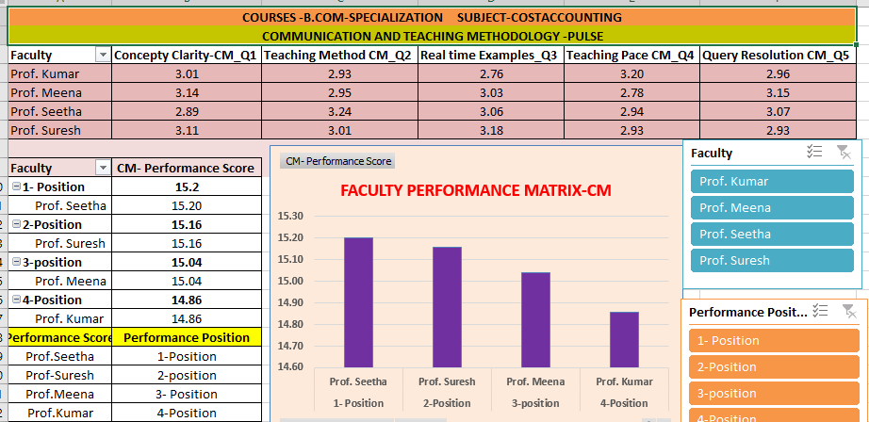
CM-PULSE
COMMUNICATION AND METHODOLOGY
BEST PERFORMER
PROF.SEETHA

Slide 12
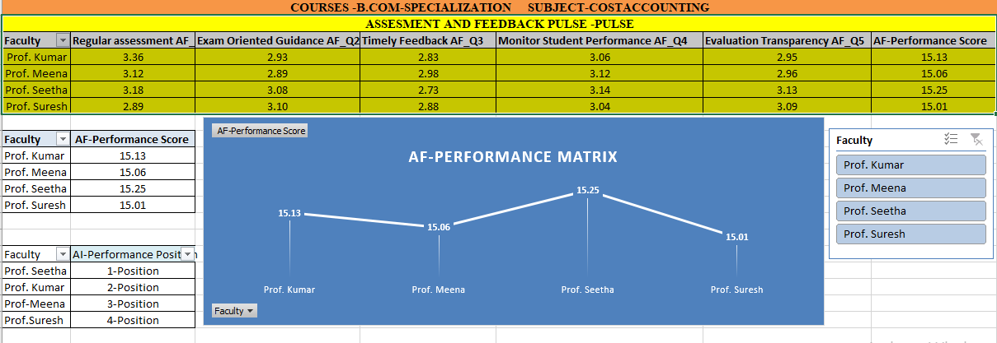
AF-PULSE
ASSESSMENT AND FEEDBACK
BEST PERFORMER
PROF.SEETHA

Slide 13
Growth and Opportunities (GO) | GO_Q1: Analytical Skills GO_Q2: Practical Application GO_Q3: Academic Growth GO_Q4: Student Participation GO_Q5: Career Growth
Skills and Employability (SE) | SE_Q1: Practical Skills SE_Q2: Industry Relevance SE_Q3: Decision Making SE_Q4: Employment Utility SE_Q5: Professional Foundation
LEARNING OUTCOME EXCELLENCE ANALYTICS

Slide 14
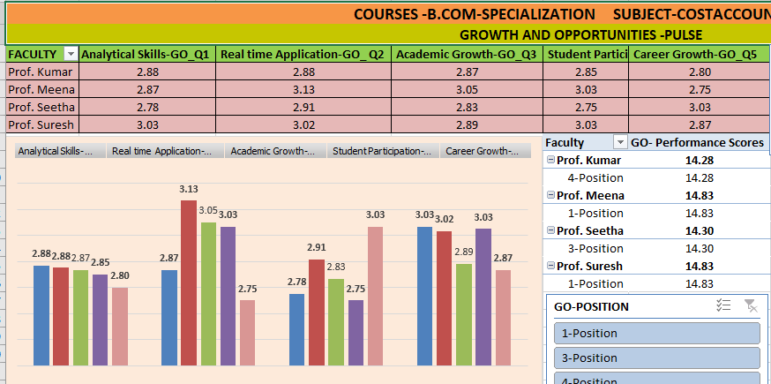
GO-PULSE
GROWTH AND OPPORTUNITIES
BEST PERFORMER
PROF.MEENA
PROF.SURESH

Slide 15
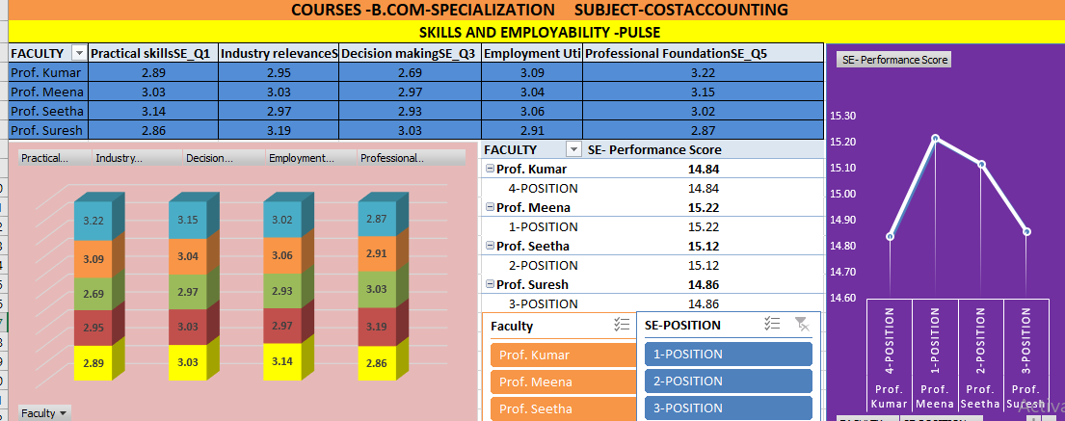
SE-PULSE
SKILLS AND EMPLOYABILITY
BEST PERFORMER
PROF.MEENA

Slide 16
Teaching Support and Engagement (TE) | TE_Q1: Academic Support TE_Q2: Study Material Quality TE_Q3: Digital tools Usage TE_Q4: Class Engagement TE_Q5: Student Motivation
SCHOLASTIC EXCELLENCE ANALYTICS
Student Fulfillment About the Faculty and Course | SF_Q1: Teaching Quality Satisfaction SF_Q2: Learning Expectations SF_Q3: Faculty Recommendation Score SF_Q4: Learning Growth Environment SF_Q5: Course Recommendation Score

Slide 17
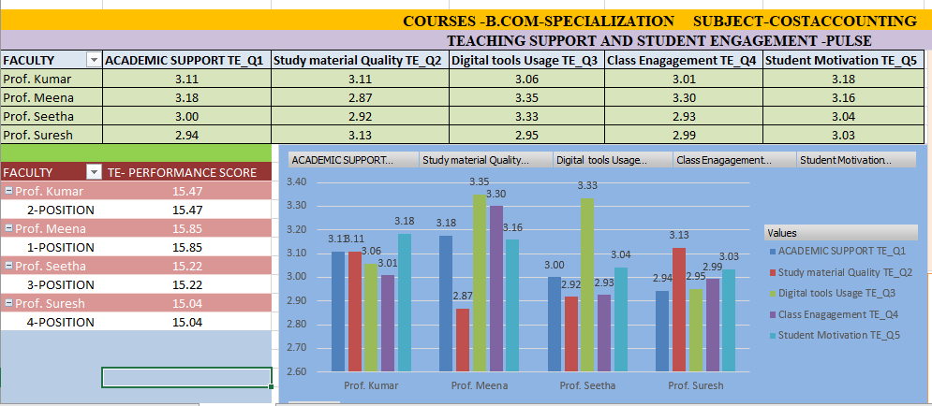
TE-PULSE
TEACHING SUPPORT AND STUDENT ENGAGEMENT
BEST PERFORMER
PROF.MEENA

Slide 18
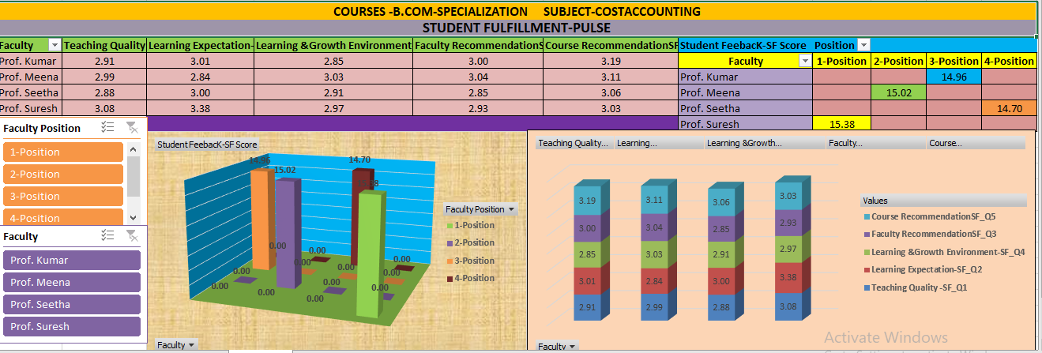
SF-PULSE
STUDENT FULFILLMENT
BEST PERFORMER
PROF.SURESH

Slide 19
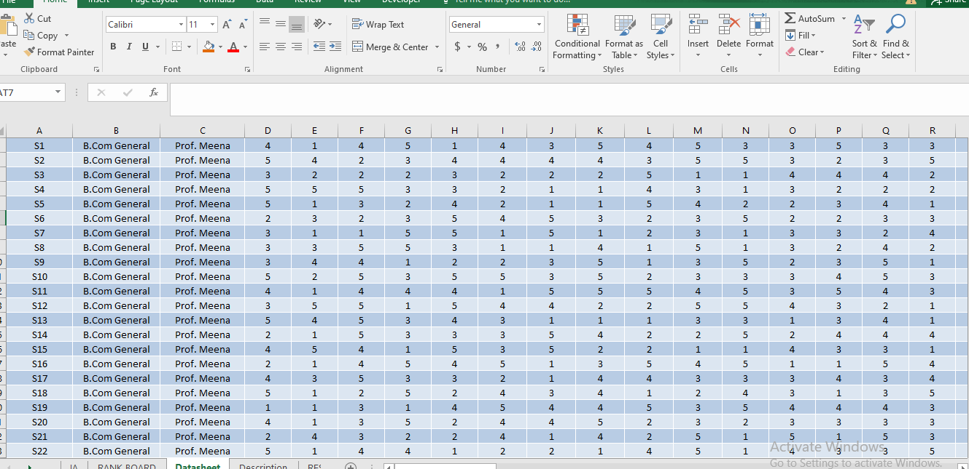
SYSTEM ARCHITECTURE
Dataset Source
The dataset base was provided by Kaggle and integrated the feedback collection initiative from the B.Com students of our institution for Cost Accounting courses across all B.Com Streams and integrated both and framed Structured Data set.
Raw and Uncleaned dataset size: Number of rows -500 and columns in the raw data-44
Cleaned Dataset Size Number of rows -480 and columns in the raw data-44

Slide 20
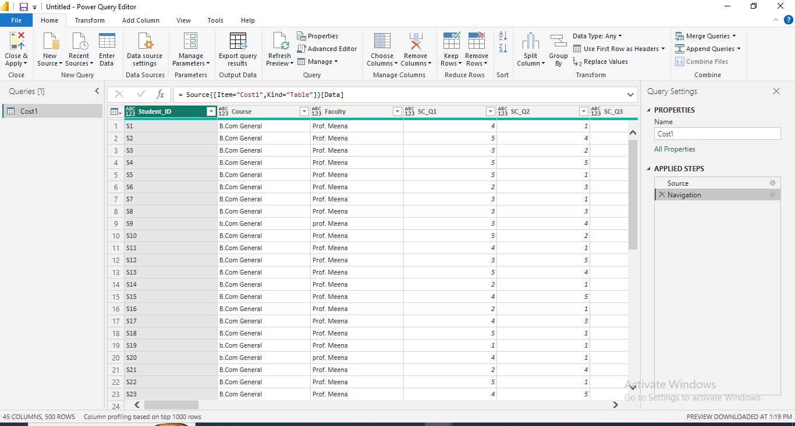
SYSTEM ARCHITECTURE
Data Cleaning –
Removed Duplicates
Checked for repeated Student_ID entries..
Dropped any exact duplicates to maintain data integrity.
Handled Null or Missing Values
Scanned all columns for blanks or missing entries.
For numerical feedback questions named SE_Q1 to SE_Q5, replaced missing values with the Average score of that question to preserve statistical balance.

Slide 21
SYSTEM ARCHITECTURE

Slide 22
SYSTEM ARCHITECTURE
Dash Board Components –MICROSOFT EXCEL
Syllabus coverage and Preparation Pulse
Communication and Teaching Methodology Pulse
Assessment and Feedback-performance Matrix
Teaching Excellence Analytics
Student Feedback Analytics
Faculty Performance-Leader Board
Teaching Learning Outcomes
Faculty Rating Validation

Slide 23
SYSTEM ARCHITECTURE
Dashboard Visualization and Insights
Clustered Column Chart – Average ratings across SE, SC, CM, AF, GO for all four faculties
Line or Area chart – Assessment and Feedback Pulse Analytics of the faculty members.
Improvement Trend Line – Plot Improvement line for the priority areas of improvement
Bar graph-Faculty performance Matrix for communication and teaching methodology.
Overall Rating Distribution Pie Chart – Show proportion of students rating faculty 1–5.
Scatter Chart –Teaching and learning Outcomes of the Faculty Members
Stacked Area Chart- Faculty Rating Validation.

Slide 24
SYSTEM ARCHITECTURE

Slide 25
LIVE DEMO OF PROJECT
MICROSOFT EXCEL
KPI -DASHBOARD
• TEACHING QUALITY EXCELLENCE
• LEARNING OUTCOME EXCELLENCE
•STUDENT EXPERIENCE EXCELLENCE
• LEADER BOARD-FACULTY PERFORMANCE METRICS

Slide 26
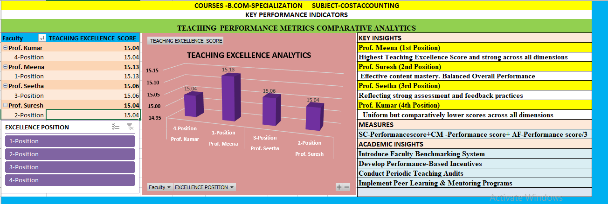
LIVE DEMO OF PROJECT
TEACHING EXCELLENCE ANALYTICS

Slide 27
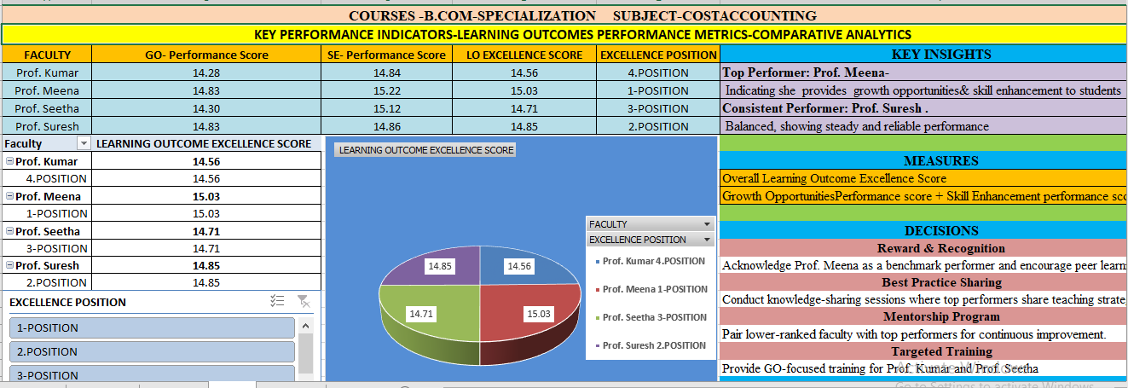
LIVE DEMO OF PROJECT
LEARNING OUTCOMES EXCELLENCE ANALYTICS

Slide 28
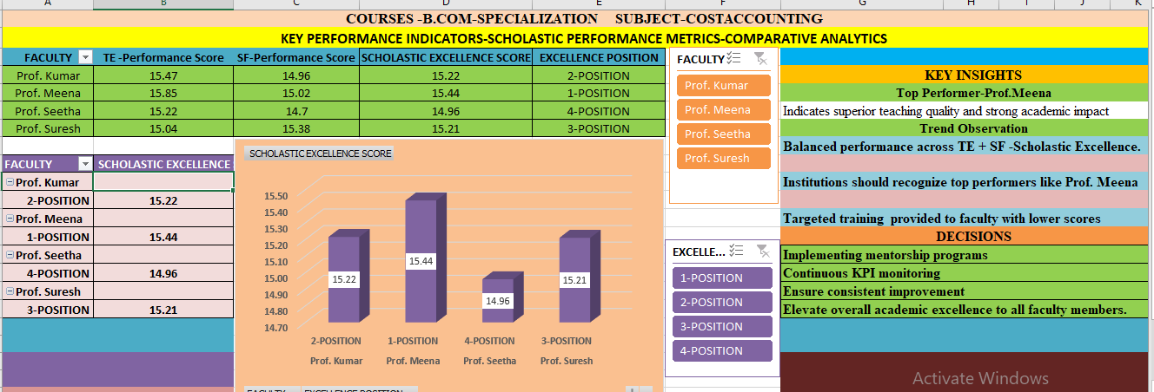
LIVE DEMO OF PROJECT
SCHOLASTIC EXCELLENCE ANALYTICS

Slide 29
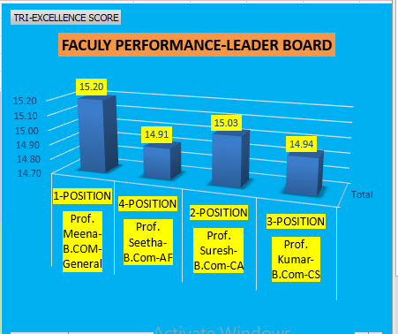
LIVE DEMO OF PROJECT
FACULTY PERFORMANCE METRICS-LEADER BOARD

Slide 30
LIVE DEMO OF PROJECT
POWER-BI
VISUALIZATION / OUTPUT RESULTS
DASHBOARD — FACULTY TEACHING QUALITY MATRIX
DASHBOARD — TEACHING LEARNING OUTCOMES

Slide 31
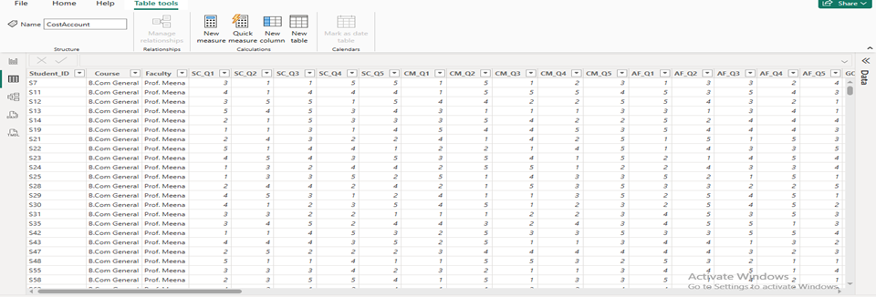
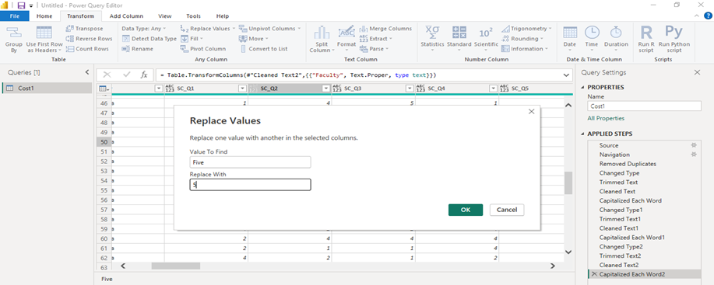
LIVE DEMO OF PROJECT

Slide 32
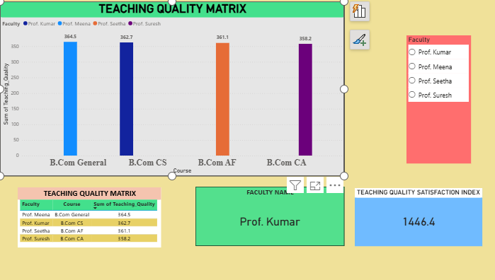
LIVE DEMO OF PROJECT

Slide 33
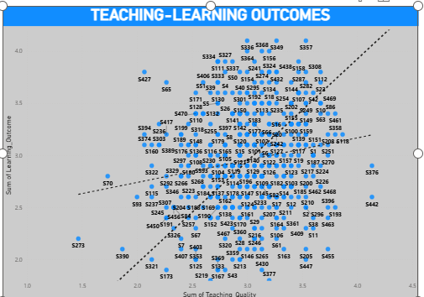
LIVE DEMO OF PROJECT

Slide 34
LIVE DEMO OF PROJECT
COPILOT STUDIO
FEEDBACK ASSISTANT CHATBOT
TESTING THE AGENT

Slide 35
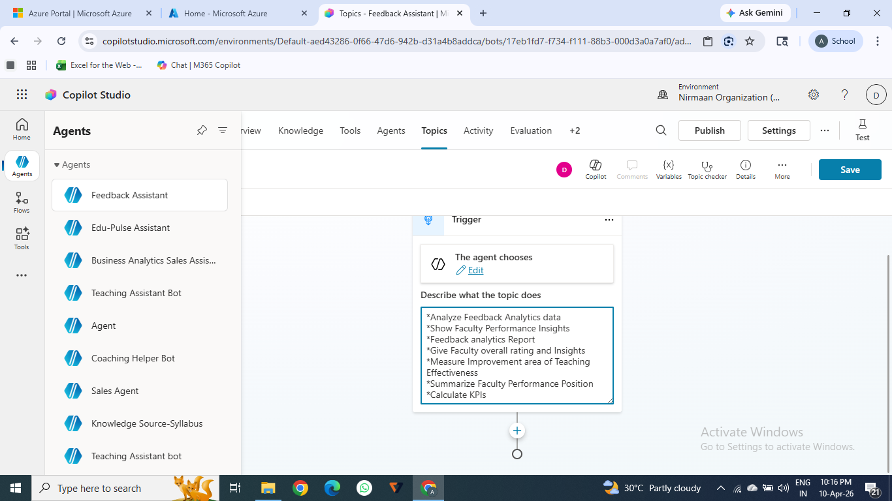
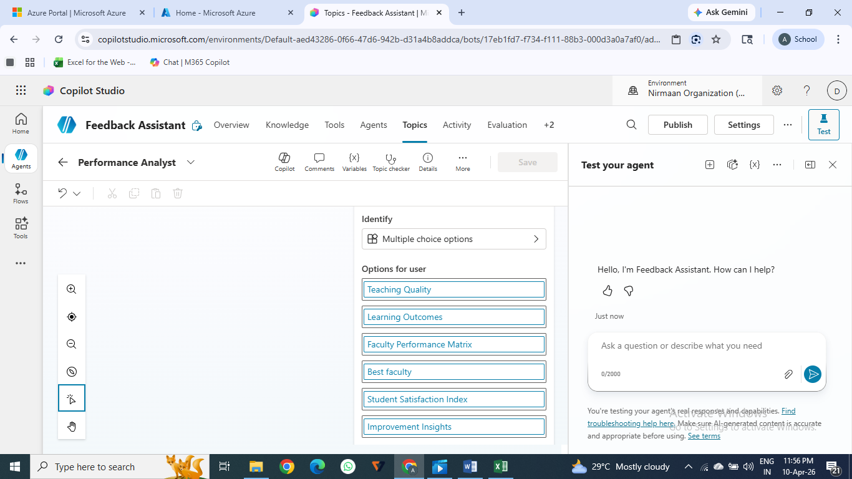
LIVE DEMO OF PROJECT

Slide 36

CONCLUSION
The project provides a comprehensive evaluation of student feedback on the Cost Accounting course through a structured, data-driven approach using Likert-scale analysis, composite indices, and comparative faculty assessment. The findings indicate an overall satisfactory level of student perception, with consistent performance across key dimensions such as syllabus coverage, teaching effectiveness, assessment practices, and skill development. However, the presence of moderate and neutral responses highlights the need for targeted improvements in engagement strategies, practical exposure, and feedback mechanisms.
By integrating analytical tools, dashboard visualization, and AI-assisted insight extraction, the project contributes to strengthening academic delivery and ensuring alignment with evolving student expectations and industry requirements.
CONCLUSION

Slide 37

FUTURE SCOPE
In the next phase, this project can be expanded by integrating qualitative feedback analysis alongside quantitative ratings to capture richer insights. Incorporating predictive analytics in Power BI could help forecast satisfaction trends and identify at-risk themes before they decline. Another enhancement would be to connect the dashboard with real-time data sources so faculty and coordinators can monitor feedback continuously rather than at the end of a term. Building faculty development recommendation modules—where AI suggests targeted training or interventions based on weak areas—would make the system more actionable and establish a standardized feedback ecosystem that supports broader educational innovation and student empowerment.

Slide 38
THANK YOU
AICW Fellowship | Student Project Presentation 2026
LinkedIn | Edunet Foundation

